Slide 1

Green Pace
Security Policy Presentation
Developer: Derek Hui
Moving from DevOps to DevSecOps.

Slide 2

OVERVIEW: DEFENSE IN DEPTH

Slide 3

OVERVIEW: DEFENSE IN DEPTH
Reasoning
This security policy is a reform in how we code
Development from DevOps -> SecDevOps
Layered Security
Outcomes
A layer of security and safety for our applications
Easier project management
Faster and better recovery
Prevention = Safety+Security in my new Empire
(Redirect Notice, n.d.)

Slide 4
THREATS MATRIX
Likely STR-30-C STR-50-CPP STR-51-CPP CTR-50-CPP MEM-51-CPP IDS-06-J | High Priority CTR-50-CPP STR-30-C STR-50-CPP STR-51-CPP MEM-51-CPP
Low priority MSC-11-C ERR-50-CPP FIO-51-CPP | Unlikely MSC-11-C FIO-51-CPP

Slide 5
PRINCIPLES
Input validation/Sanitization: STR-50-CPP ; IDS-06-J
Least privilege: FIO-51-CPP
Keeping it simple: MSC-11-C ; ERR-50-CPP
Complete mediation: IDS-06-J ; FIO-51-CPP ; ERR-51-CPP
Heed compiler warnings
Architecture for security policies
Default Deny/Secure By Default: STR-51-CPP ; CTR-50-CPP ;MEM-51-CPP
Defense in depth: STR-30-C ; ERR-51-CPP
Quality assurance
Adopting standards
Open design: MSC-11-C

Slide 6
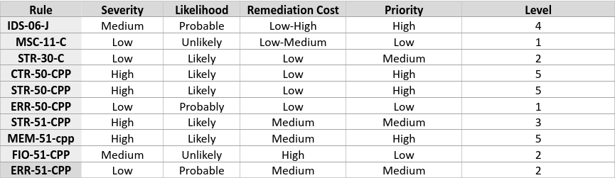
CODING STANDARDS
EXAMPLES
STR-50-CPP → high severity, high priority = big issue
ERR-50-CPP → low severity, low priority = reasonable fix and easy to handle

Slide 7
ENCRYPTION POLICIES
AT REST
Data:
user information
files
databases
cloud storage
Symmetrical algorithms
IN FLIGHT/TRANSIT
Data:
Text messaging
emails
patch deployment
IN USE
Any sensitive data being used in memory

Slide 8
TRIPLE-A POLICIES
Authentication is the WHO?
username login
certificate checking in website requests
IP address tracing
Authorization is the WHAT?
File accessing
page accessing
read/write privileges
Accounting is the WHEN/WHERE
logging of user actions
files edited
timestamp of when
what device?
in network or from outside?

Slide 9
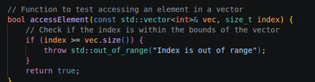
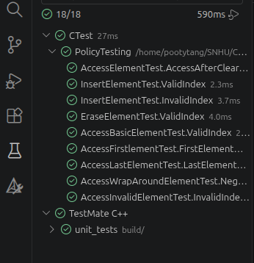
Unit Testing
Unit test of: CTR-51-CPP (container accessing)
Test type:
Positive:
Accessing a basic element
Accessing first element
Inserting an element
Negative
Access with invalid element
Access OTB with integer wraparound
Insert at bad index

Slide 10
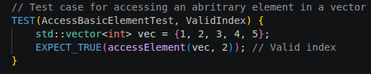
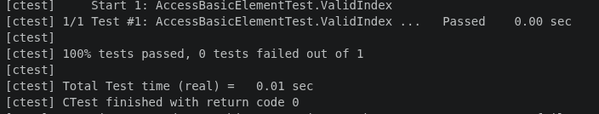
AccessBasicElementTest()

Slide 11
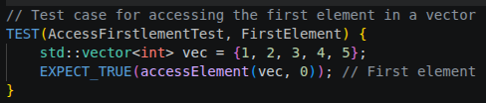
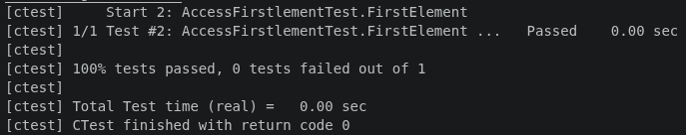
AccessFirstElementTest()

Slide 12
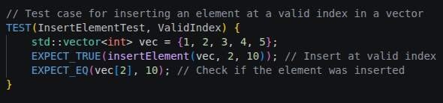
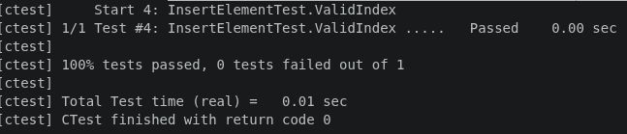
InsertElementTest()

Slide 13
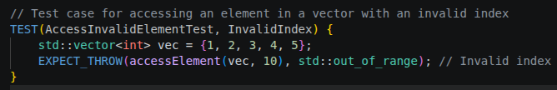
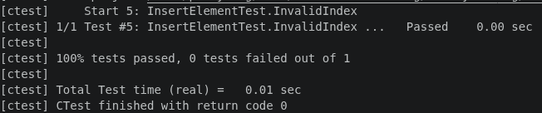
AccessInvalidElementTest()

Slide 14
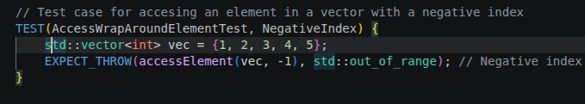
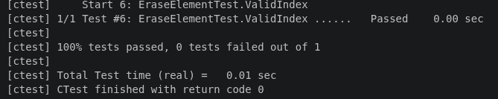
AccessWrapAroundElementTest()

Slide 15
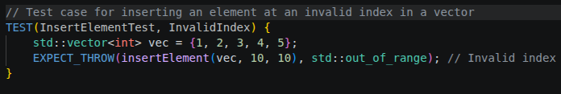
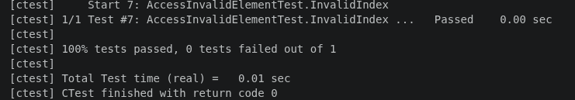
InsertElementTest()

Slide 16

AUTOMATION SUMMARY

Slide 17
TOOLS
The Pipeline
DevOps → security added at end of production
DevSecOps → cyclical in the production cycle, added at various phases
Tools
CppCheck → Planning Phase
Live code checker for language specific errors.
Klocwork → Build Phase
comparator from CERT rules to written code
Polyspace Test → Test and Validation
memory leak checker

Slide 18
RISKS AND BENEFITS
The Quick Route(Now)
PROS:
Smaller code base to work with
More attention to detail during development
Easier to audit
CONS:
No time to prepare
Lack of training on policy and standards
extra initial workload for staff
The Slow Route(Wait)
PROS:
More time for preparation
Organization for team members
Better training
CONS:
Larger codebase to work on
More chance of errors
Essential rerun of entire dev process
Slow down of future projects

Slide 19
RECOMMENDATIONS
Protections Currently:
Container accessing
Some string protection(generation, madofication, spacial checking)
Input protection
Memory control
Assertion in testing & exception handling
Program termination & file control
What more can we do??
Enforce the current policy
Hold periodic meetings for new improvements
The recommendations listed are not exhaustive by any means but this is by design. We will slowly implement more standards and scope to this policy over time to reduce information overload for our employees.

Slide 20
CONCLUSIONS
Incorporate DCL-58-CPP (Namespace modifications)
No integer standards, include INT-30-C (Unsigned integer operations)
MSC-41-C (Never hardcode sensitive information)

Slide 21
REFERENCES
SEI CERT C++ Coding Standard | CERT Secure Coding. (n.d.). https://cmu-sei.github.io/secure-coding-standards/sei-cert-cpp-coding-standard/
Redirect notice. (n.d.). https://www.google.com/url?sa=t&source=web&rct=j&url=https%3A%2F%2Fscreenrant.com%2Fstar-wars-revenge-sith-anakin-skywalker-yellow-eyes-why%2F&ved=0CBkQjhxqFwoTCKDat-uappYDFQAAAAAdAAAAABAJ&opi=89978449

